Slide 1

0HV130
Applied Data Skills
Introduction
Gerrit Rooks

Slide 2
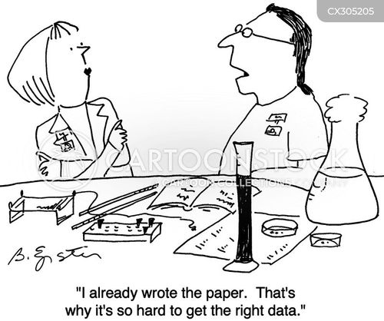

Data fabrication “making up data or results and recording or reporting them” Data falsification “changing or deleting data for fraudulent purposes” Authorship fraud misbehavior when allocating authorship credit Plagiarism not only includes traditional forms of stealing others’ words, ideas, and research findings
There are many ways in which researchers can fools themselves and others.

Slide 3
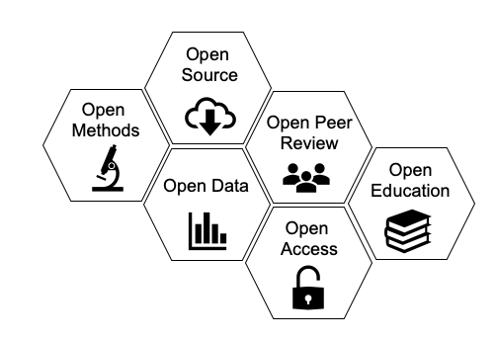
Open science
Open science is
“an umbrella term used to refer to the concepts of openness, transparency, rigor, reproducibility, replicability, and accumulation of knowledge, which are considered fundamental features of science”

Slide 4

Reproducibility ≠ replicability
Reproducibility = obtaining consistent computational results using the same input data, computational steps, methods, code, and conditions of analysis.
Replicability = obtaining consistent results across studies aimed at answering the same scientific question

Slide 5
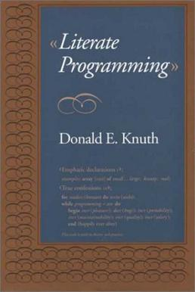
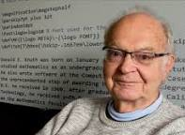
Literate programming
Reproducible reports are greatly helped by the principles of literate programming
Literate programming is a methodology that combines a programming language with a documentation language
Literate programming helps data analysis and reproducible workflows it makes our data-analytic programs more clear, transparent, robust, more portable, more easily maintained.

Slide 6

Naming Files
This is not trivial!
I often get reports or assignments without identifiers (report_v13a.doc). Messy!
Use the tips and principles explained in the book.

Slide 7

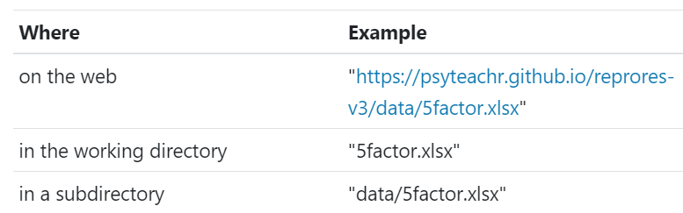
File management
You usually want to have all of your scripts and data files for a single project inside one folder on your computer, the working directory for that project.
Our book recommends having only three locations: wd, sub-wd, or the web
Do not include full paths

Slide 8
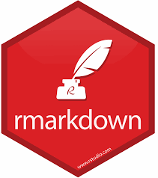
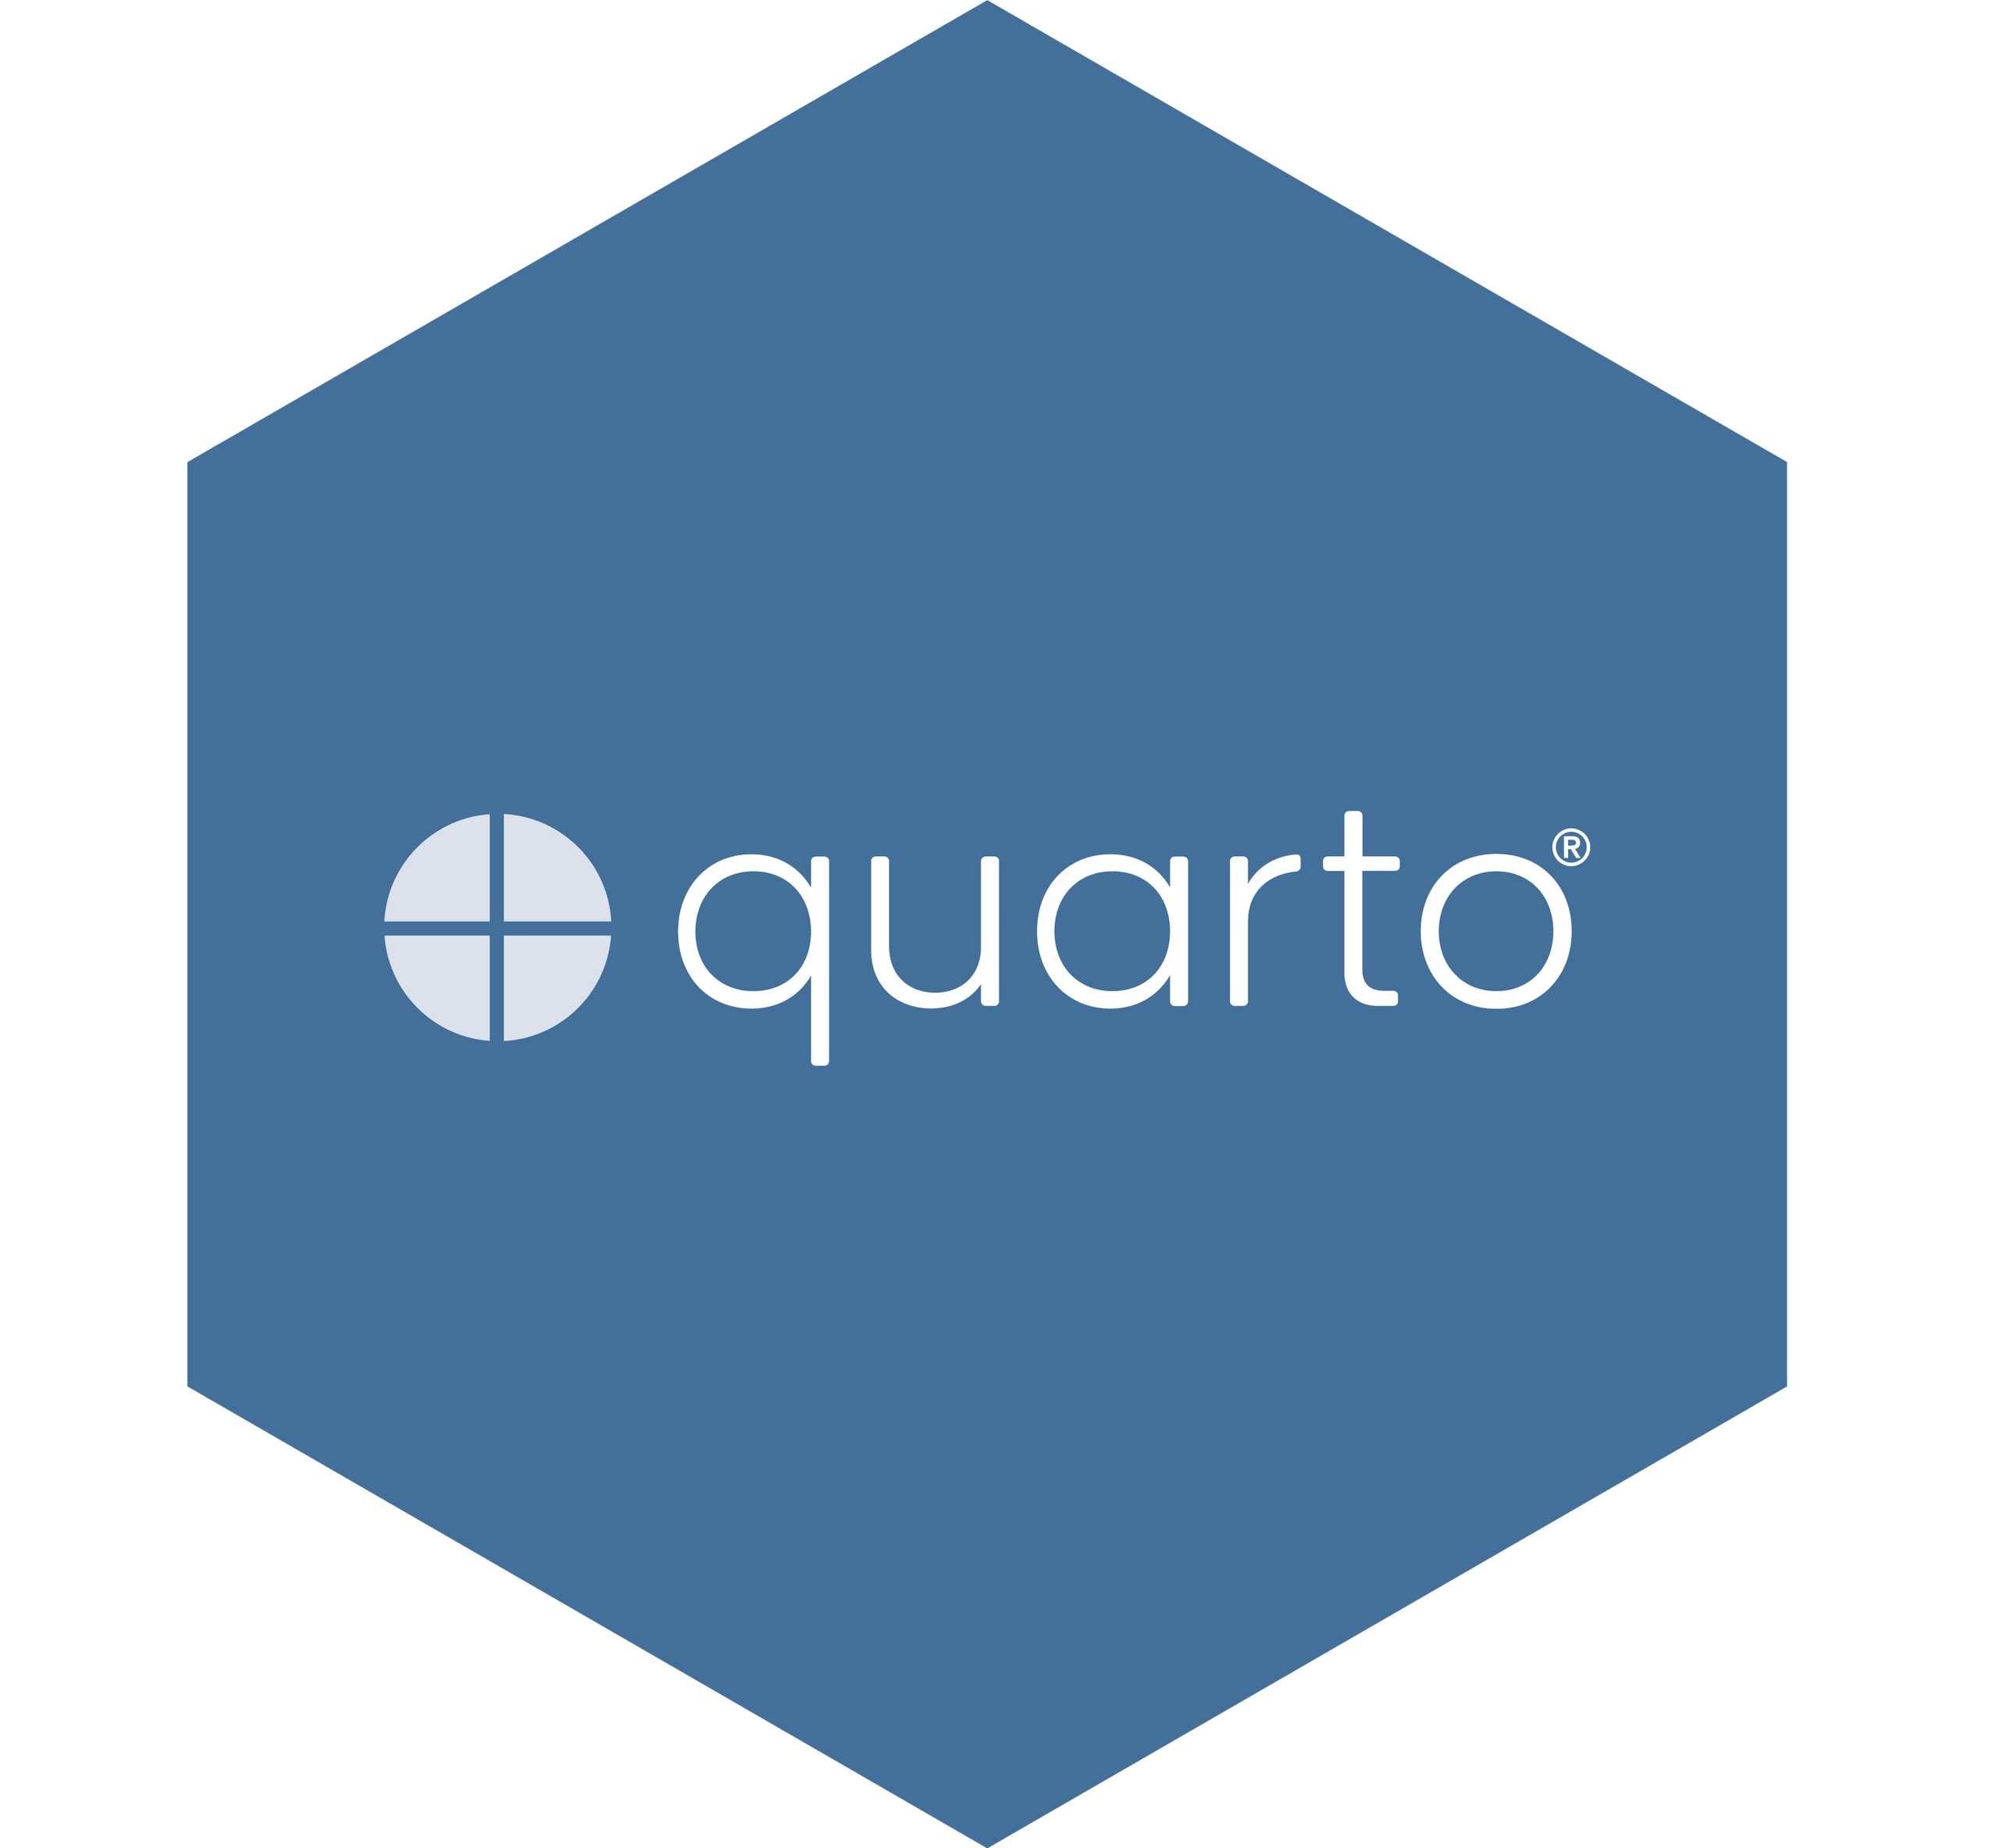

Rmarkdown
We’ll use RMarkdown to produce reproducible reports. This is an R package and is used in the book.
Quatro is a recent open-source scientific and technical publishing system that is very similar.
The step from Rmarkdown to Quatro is small.

Slide 9
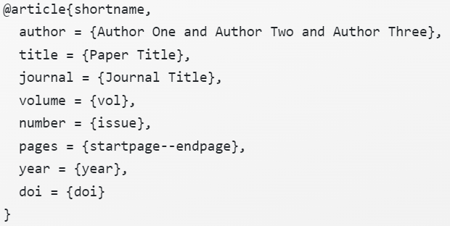

Adding a bibliography in Rmarkdown
RMarkdown files need to link to a BibTex or JSON file (a plain text file with references in a specific format) that contains the references you need to cite.
Install Zotero (which is also excellent for use with Word!!) this helps you tremendously in your projects.

Slide 10
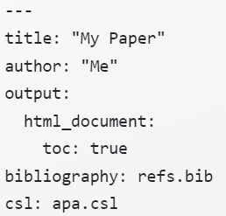
Adding a bibliography in Rmarkdown
To work with a bibliography, you need to name include it in the YAML
If you want a specific reference style (Engineering IEEE Style or American Psychological Association “apa”) download a “csl” file from zotero https://www.zotero.org/styles
This file should be placed in the working directory.

